Slide 1


TY Coding
Lesson 07 - Iteration

Slide 2
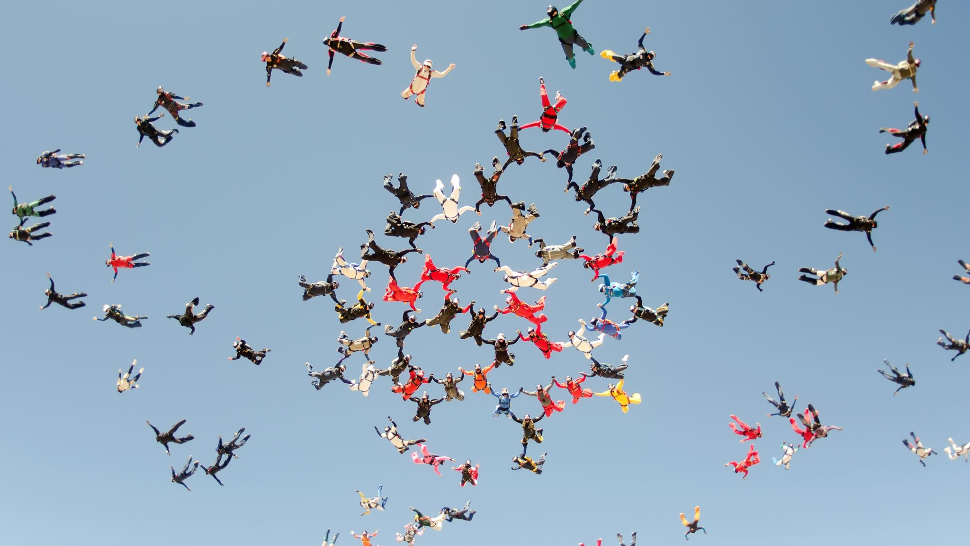
What is Iteration?
Iteration is the form of program control that allows us to instruct the computer to carry out a task over and over again by repeating a section of code, also called repetition, e.G. Taking in data from the user relating to multiple employees, students, repeated calculations etc.
The program structure that is used to control this repetition is called a loop.
There are two types of loops in python
While
For

Slide 3
The while loop

Slide 4
The while statement continually executes a block of statements while a particular condition is true, similar structure to an if statement.
The while statement evaluates the condition, which must return a boolean value, either true or false.
counter = 0
while counter < 10:
print(counter)
counter += 1
Indentation is really important
Indented code is run inside of the loop

Slide 5


The While Loop
Lets build a program which prints and counts from a start number to an end number.
So, what inputs will our program need?
Inputs: startNumber, endNumber
So we want to print all the numbers between the startNumber and the endNumber and add all the numbers up too.

Slide 6
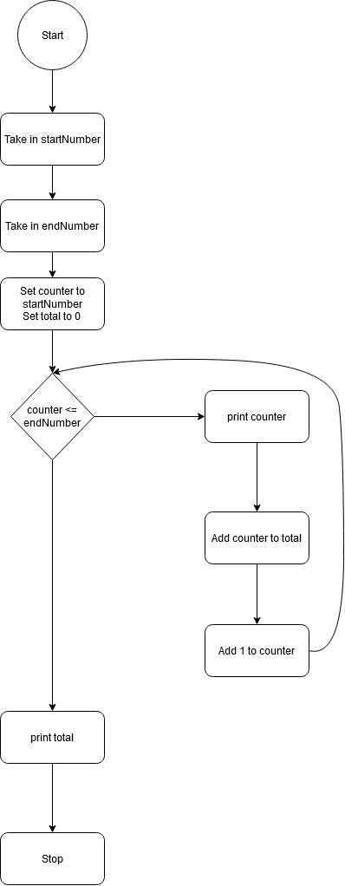
An algorithm is a set of steps to be followed to solve a problem. This is what the algorithm for our program would look like

Slide 7
INDENTATION
WHILE COUNTER <= ENDNUMBER:
PRINT("THE COUNTER VALUE IS :",COUNTER)
TOTAL += COUNTER
COUNTER +=1
Notice the indentation! This is extremely important in python.
It indicates what block of code belongs to what statement.

Slide 8
STARTNUMBER = INT(INPUT("PLEASE ENTER A START VALUE: "))
ENDNUMBER = INT(INPUT("PLEASE ENTER AN END VALUE: "))
COUNTER = STARTNUMBER
TOTAL = 0
WHILE COUNTER <= ENDNUMBER:
PRINT("THE COUNTER VALUE IS :",COUNTER)
TOTAL += COUNTER
COUNTER +=1
PRINT("TOTAL IS :",TOTAL)
INPUT:
STARTNUMBER = 1
ENDNUMBER = 5

Slide 9
counter
total
1
1
2
3
3
6
4
10
5
15
The counter value is : 1
The counter value is : 2
The counter value is : 3
The counter value is : 4
The counter value is : 5
Total is : 15

Slide 10

The While Loop
Lets build another program which reads in characters from the keyboard. The program should stop when the letter ‘z’ is entered.
So, what inputs will our program need?
Inputs: inputLetter
We want to end when the letter ‘z’ is entered.

Slide 11
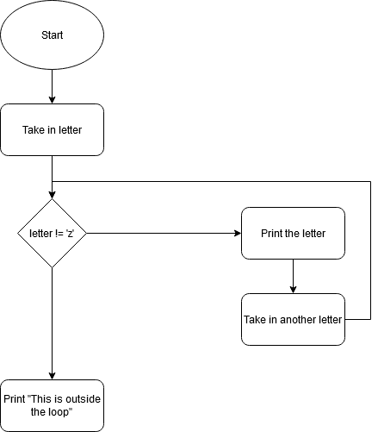
Program Algorithim
An algorithm is a set of steps to be followed to solve a problem. This is what the algorithm for our program would look like

Slide 12
SO WHAT DOES THIS LOOK LIKE IN OUR CODE?
inputletter = input("please enter a letter: ")
while inputletter != ‘z’:
print(“the entered letter is :",inputletter)
inputletter = input("please enter another letter: ")
Print(“this is outside the loop”)
Please enter a letter: a
Please enter a letter: b
Please enter a letter: c
Please enter a letter: z
This is outside the loop

Slide 13
The
for
loop

Slide 14
The For Loop
Similar to the while the loop, the for loop will consist of the for keyword. The for loop works best for counting.
With a for loop we use the range function to define a range to count between.
for i in range(1,6):
print(i)

Slide 15
The For Loop
Lets build a program which prints and counts from a start number to an end number.
So, what inputs will our program need?
Inputs: startNumber, endNumber
So we want to print all the numbers between the startNumber and the endNumber and add all the numbers up too.

Slide 16
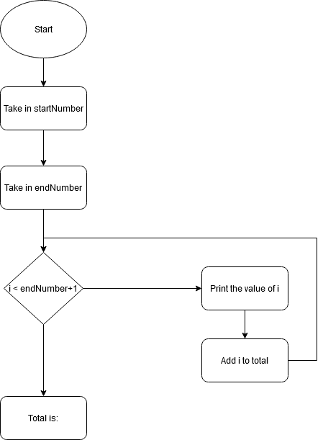
An algorithm is a set of steps to be followed to solve a problem.
This is what the algorithm for our program would look like

Slide 17
The For Loop
startNumber = int(input("Please enter a start value: "))
endNumber = int(input("Please enter an end value: "))
total = 0
for i in range(startNumber, endNumber+1):
print("The value of i is:",i)
total += i
print("Total is :",total)
---
Input:
Please enter a start value: 1
Please enter an end value: 10
Output:
The value of i is: 1
The value of i is: 2
..
The value of i is: 10
Total is : 55

Slide 18
i
total
1
1
2
3
3
6
4
10
5
15
The value of i is: 1
The value of i is : 2
The value of i is : 3
The value of i is : 4
The value of i is : 5
Total is : 15

Slide 19

Another Loop
Lets build a program which prints each character in a name
So, what inputs will our program need?
Inputs: inputName
So we want to print all the characters in a string.

Slide 20
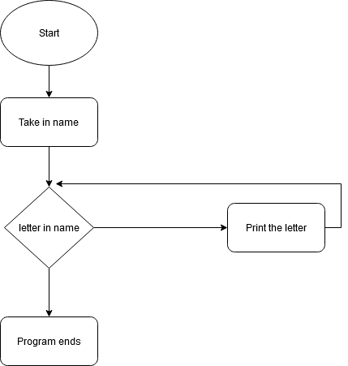
An algorithm is a set of steps to be followed to solve a problem. This is what the algorithm for our program would look like

Slide 21
So what does this look like in our code?
inputname = input("please enter a name: ")
For letter i in inputname:
print("the letter is:",letter)
Input:
Please enter a name: john
Output:
The letter is: j
The letter is: o
The letter is: h
The letter is: n

Slide 22
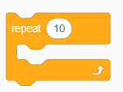
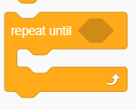
Scratch Equivalent
For Loop –
While -

Slide 23
Summary
Today you learned about:
While loop.
Better suited for unknown endings like when ‘z’ is entered.
Loop ends when the condition is met.
For loop.
Best for running between two particular numbers or a range or a set number of times.
Best for printing letters from a string.

